Slide 1
Big Mountain Resort Ticket Price Recommendations
Jack Wolfgramm

Slide 2
Is the ticket price correct?
Concerns have been raised about the accuracy of the ticket price.
Installing a new run has led to the desire to see if prices can be raised.
Until now, no research has been done on the price of competitors.
So, we analyzed the nationwide data to determine what the fair price for admission to Big Mountain Resort should be.

Slide 3
Recommendations and Key Findings
Based on our analysis, we recommend increasing the price for the weekend ticket from $81.00 to around $95.85.
The error on this estimate is around $10.00, which still shows that there is a good margin for increase.
We also found that closing the least used run makes no difference in (predicted) idea ticket price.
Finally, adding a run, increasing the vertical drop by 150 feet, and installing an additional chair lift would increase ticket price by another $1.99.

Slide 4
Modeling results and analysis
We determined that the most accurate model for our data was a “Random Forest”.
Our model assumes that the (on average) price of resorts is accurate.
The most important variables were found to be
Having a run with a high vertical drop
The number of acres with snow making capabilities
The total number of runs available
Big Mountain resort fares well to nationwide competitors on all of these fronts.

Slide 5
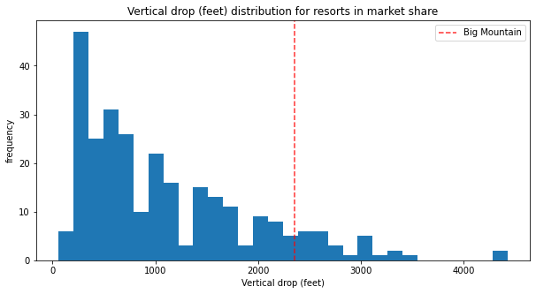
Vertical Drop Distribution

Slide 6
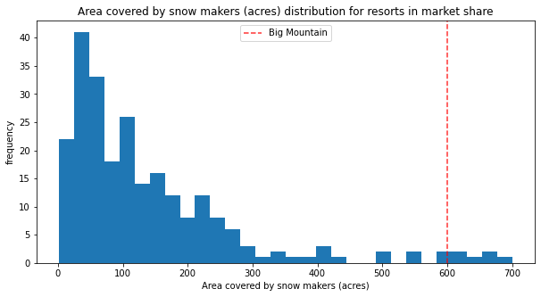
Snow Making Area Distribution

Slide 7
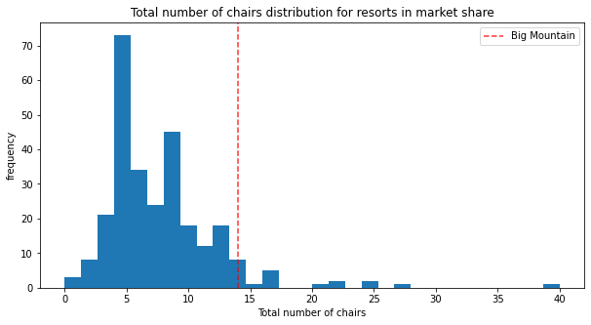
Total Number of Chairs Distribution

Slide 8
Summary and conclusion
Data analysis confirms that the weekend price for Big Mountain Resort is too low.
Big Mountain Resort has strengths in the most important features.
We recommend increasing the price by around 12 dollars.
Closing the least used chair will not drive ticket price down.

